Slide 1
Finding Financial Support

Slide 2
Learning Objectives
Identify at least two federal programs that offer financial support.
Demonstrate how to research state and local programs that offer financial support.
Explain why students can be confident in the financial future of a career in family medicine.
Address realities of the financial implications of a career in family medicine, including the cost of medical education and accurate FM employment and payment prospects.

Slide 3
AAMC Fee Assistance Program
Provides financial assistance to help cover the costs associated with applying to medical school.
aamc.org/fap
Notes:
However, there is good news! The AAMC firmly believes that the cost of applying to medical school should not deter you from becoming a doctor, so that’s why there is – The Fee Assistance Program.
This program assists those who, without financial assistance, would be unable to take the MCAT exam, apply to medical schools with the AMCAS application, or use some of the other AAMC resources.

Slide 4
FAP Eligibility
U.S. based home address
Approval tied to U.S. Department of Health and Human Services' poverty level guidelines
Parental information required for applicants under age 26
Notes:
You are eligible for the Fee Assistance Program if - prior to completing your Fee Assistance Program application - you have a US-based address.
Fee Assistance Program award approval is tied directly to the U.S. Department of Health and Human Services' poverty level guidelines.
Parental financial information and supporting tax documentation are required for applicants under age 26. Parental information is viewed independently from applicant data but must also fall within eligibility guidelines.

Slide 5
Benefits
Reduced MCAT registration and rescheduling fees
Free MCAT preparation resources
Complimentary access to the MSAR (Medical School Admission Requirements) database
Waiver for all AMCAS® (American Medical College Application Service®) fees (up to 20 medical school designations)
Waiver for AAMC PREviewTM exam registration fees
Consideration for a stipend to assist with the cost of an updated evaluation, if needed for MCAT Accommodations (Requires an additional application)
Remember!
Benefits are NOT retroactive
Notes:
If you are approved for Fee Assistance, you will receive:
Reduced MCAT registration fees. Registration for the MCAT exam is currently $330. If approved for fee assistance, the registration price is reduced to $135.
MCAT Preparation Products so you receive the MCAT Official Prep Online-only bundle.
Complimentary access to the Medical School Admission Requirements website for two years.
A waiver for all AMCAS fees for one (1) application submission with up to 20 medical school designations. It’s also important to note, that many medical schools waive their secondary application fees for those who qualify for fee assistance.
A waiver for the AAMC PREviewTM professional readiness exam registration fees
I also want to mention, that if you are awarded fee assistance and you are applying for testing accommodations for the MCAT, you have access to a stipend towards an evaluation if it is required to support your MCAT accommodations application.
Benefits are not retroactive, so in order to use your benefits you must apply before you register for MCAT or submit your AMCAS application. And since MCAT prep products are included the best time to apply to the Fee Assistance Program will be before you plan to study for the MCAT exam, this way you are able to take advantage of all the benefits the program offer.
If you were awarded and used all the Fee Assistance Program benefits available to you, you would save more than $2000.

Slide 6
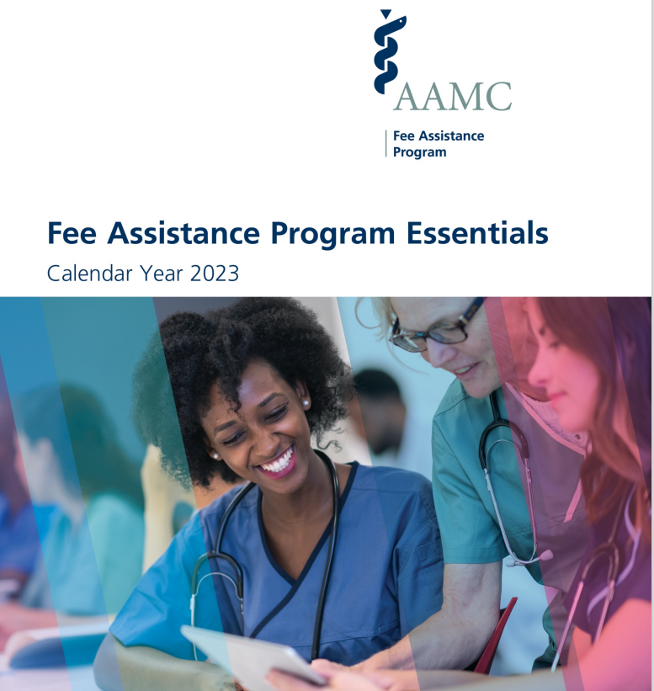
202-828-0600
fap@aamc.org
@AMCASinfo
Notes:
If you need assistance completing the Fee Assistance Program application, please contact out Services Contact Center. They are open Monday – Friday from 9 AM to 7 PM ET. You can call (202) 828-0600 or email them using the email addresses you see on the screen.
Visit our website aamc.org/fap to start an application. I also encourage you to review our Fee Assistance Program Essentials. These Essentials will detail how to complete the Fee Assistance Program application.

Slide 7
Federal Programs
National Health Service Corps (NHSC)
Indian Health Services (IHS)
Commissioned Corps of the U.S. Public Health Service
Department of Veterans Affairs
Military
Review : Loan Forgiveness, Scholarship and Service Programs - aamc.org/repayasst

Slide 8
National Health Service Programs
Scholarship Program
Loan Repayment Program
Substance Use Disorder Workforce LRP
Rural Community LRP
Students to Service LRP
nhsc.hrsa.gov

Slide 9
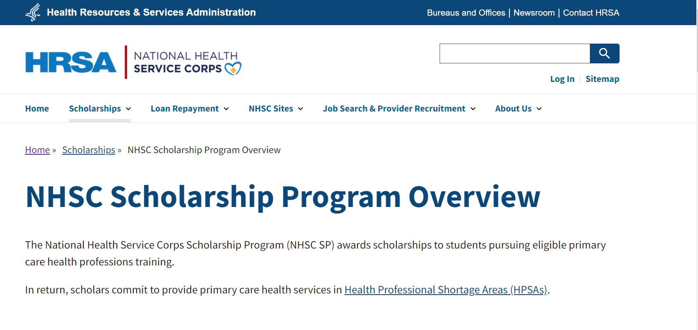
nhsc.hrsa.gov/scholarships/overview

Slide 10
Compare the NHSC Programs
nhsc.hrsa.gov/sites/default/files/nhsc/loan-repayment/loan-repayment-comparison.pdf

Slide 11
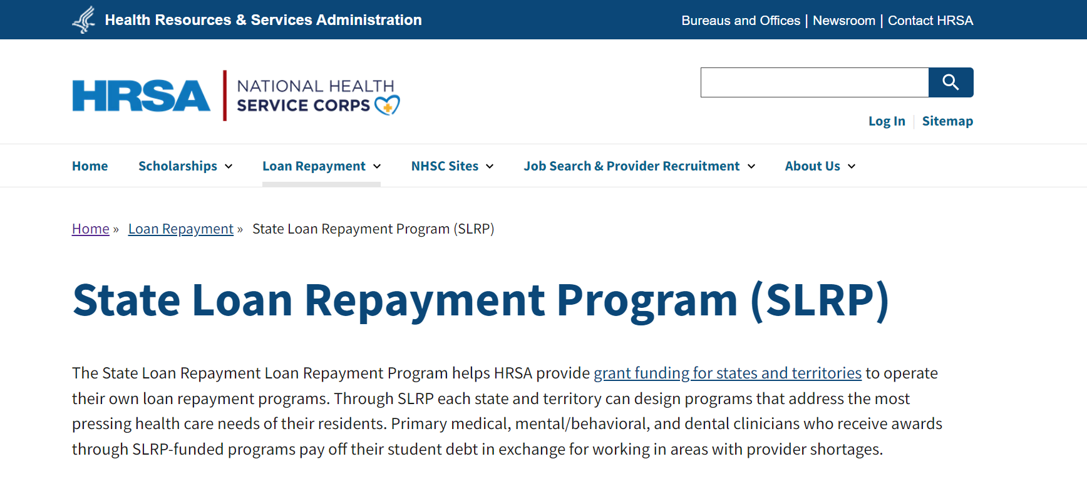
nhsc.hrsa.gov/loan-repayment/state-loan-repayment-program

Slide 12
nhsc.hrsa.gov/sites/default/files/nhsc/loan-repayment/nhsc-s2s-lrp-fact-sheet.pdf

Slide 13
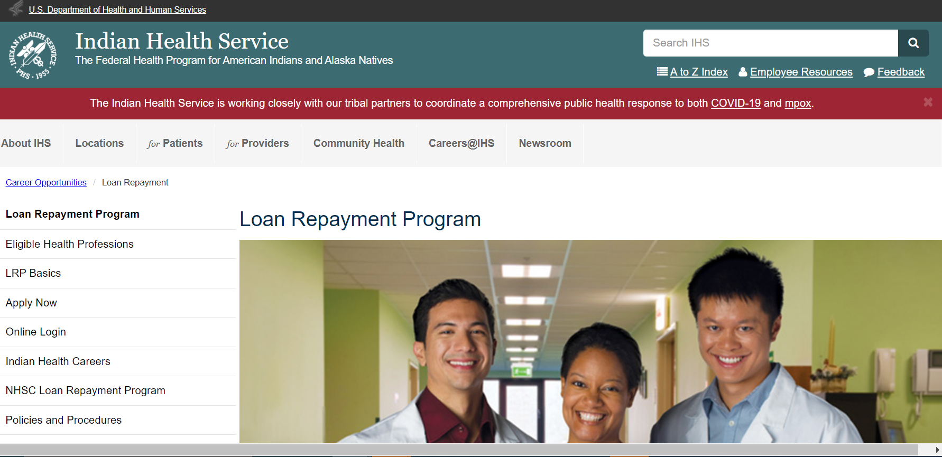
ihs.gov/loanrepayment/

Slide 14
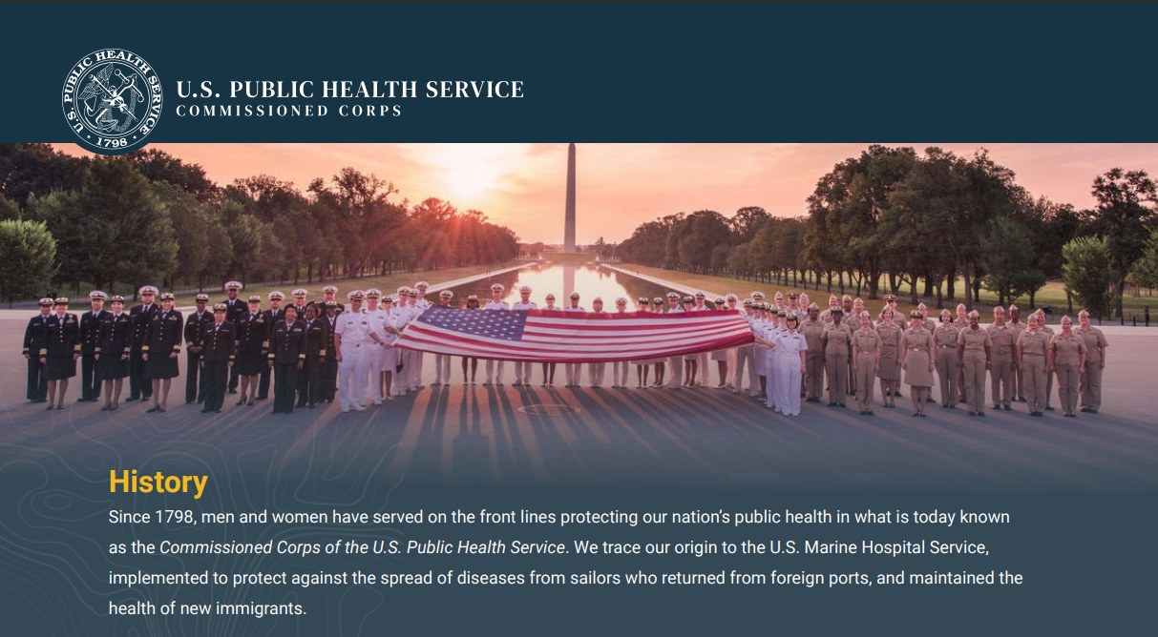
One of the eight uniformed services
Dedicated solely to protecting America’s public health
Commissioned offers receive uniformed service benefits
Applicants must complete commissioning process and secure position in an agency where Public Health Service officers serve
usphs.gov/media/gjwha2tw/about-us-factsheet.pdf
Notes:
From USPHS Commissioned Corp Flyer:
“. Who We Are The Commissioned Corps of the U.S. Public Health Service is one of the eight uniformed services, and is the only one dedicated solely to protecting America’s public health: • Led by the Assistant Secretary for Health and U.S. Surgeon General • Composed of nearly 6,100 full-time, highly qualified public health officers and • Specialties include: physicians, dentists, nurses, pharmacists, clinical and rehabilitation therapists, dieticians, engineers, environmental health and health service officers, scientists, and veterinarians. What We Do Protect, Promote and Advance the Health and Safety of our Nation • Provide Essential Healthcare Services to underserved and vulnerable populations. • Deploy for Public Health Emergencies. As the cornerstone of U.S. crisis response, officers deploy to natural disasters, disease outbreaks, global public health emergencies, and serve on humanitarian assistance missions. • Lead Public Health Programs and Policy Development. Officers leverage their extensive experience, skills, and networks to provide expert leadership within HHS and throughout the federal government. • Advance Innovation and Science. Clinicians and research scientists work at the forefront of the battles against the COVID-19 response, Ebola, cancer, food safety, HIV, mental health and more.”

Slide 15
VA Health Professional Scholarship Program (HPSP)
Pays school tuition and approved fees
Recipient receives monthly stipend for each month enrolled in coursework
Must provide service commitment of 18 months (for every year sponsored) at a VA facility after graduation, licensure and residency
va-ams-info.intelliworxit.com/hpsp/about-hpsp

Slide 16
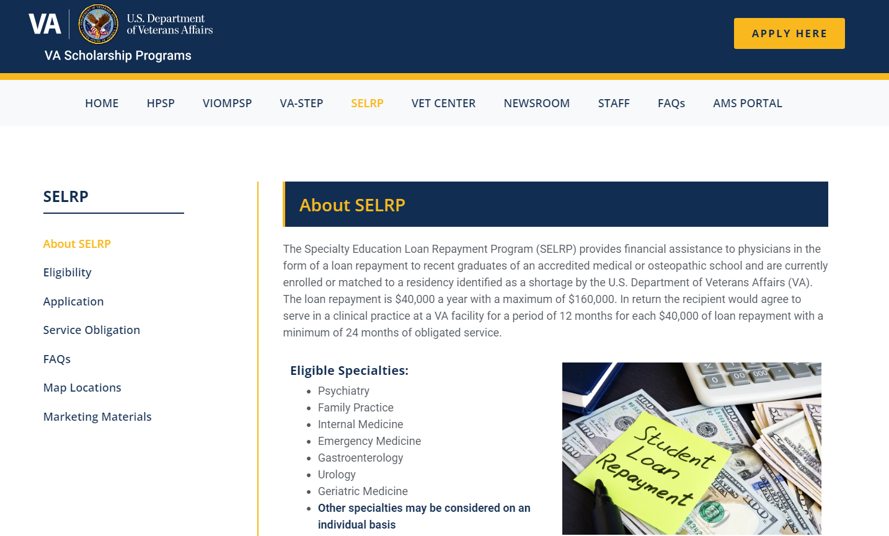
va-ams-info.intelliworxit.com/selrp/about-selrp/
Notes:
SELRP Overview
The Specialty Education Loan Repayment Program (SELRP) provides loan repayment assistance up to $40,000 a year with a maximum of $160,000 for qualified health profession education loans.
Service Commitment
Recipients agree to serve in a clinical practice at a VA facility for a period of 12 months for each $40,000 received, and they must provide a commitment of service for a minimum of 24 months. Degree and licensure requirements must also be met.

Slide 17
Military Programs for Physicians
Air Force
airforce.com/careers/specialty-careers/healthcare/careers/doctor
Army
goarmy.com/careers-and-jobs/specialty-careers/health-care.html
National Guard
nationalguard.com/amedd
Navy
med.navy.mil/Medical-Corps/

Slide 18
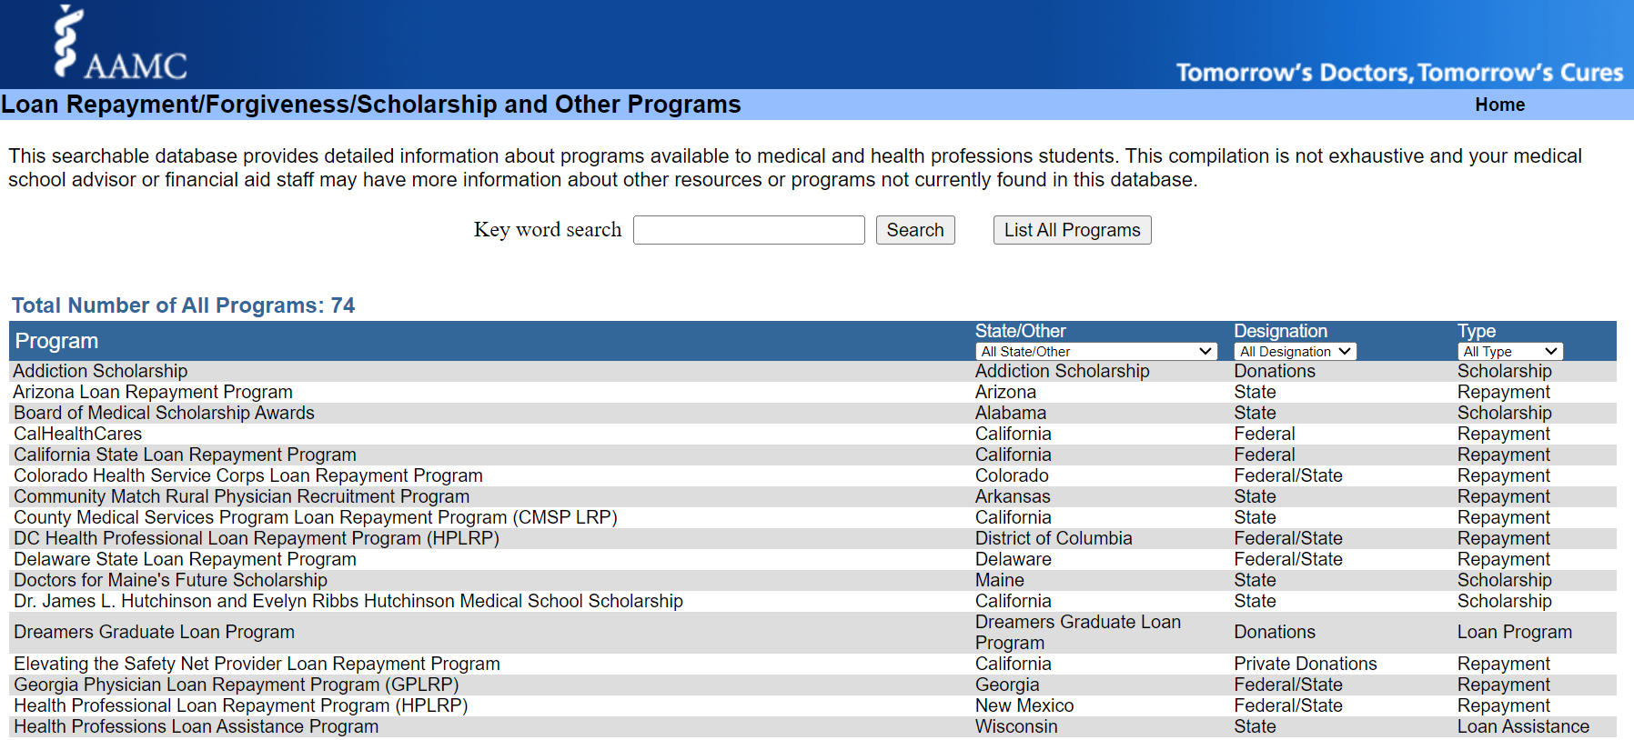
aamc.org/stloan

Slide 19
MAKE
120
QUALIFYING PAYMENTS
ENROLLED
IN A
QUALIFYING REPAYMENT
PLAN
PUBLIC SERVICE
LOAN FORGIVENESS (PSLF)
PROGRAM
EMPLOYED
FULL-TIME BY
QUALIFYING EMPLOYER
REPAYING QUALIFYING
DIRECT
LOANS
Tax Free Forgiveness
studentaid.gov/pslf
Notes:
Public Service Loan Forgiveness is a federal program for borrowers with Direct Loans, who make 120 qualifying payments while enrolled in a qualifying repayment plan, while working full-time for a qualifying non-profit employer. This is a great program for those who may be interested in working in the non-profit sector. You may want to review Module 6 for more information about this topic.

Slide 20
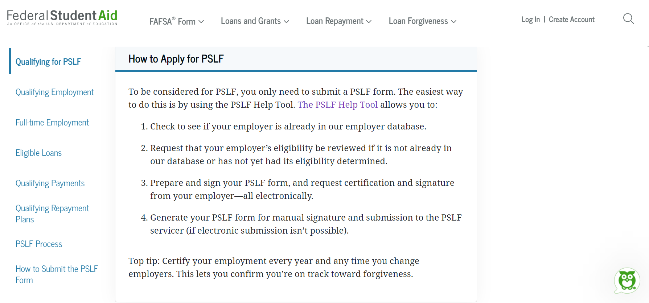
studentaid.gov/pslf

Slide 21
Family Medicine Repayment Example $200,000 Borrowed (Direct Loans) Residency Stipend PGY-1: $62,700 Post-Residency Salary: $255,000
Repayment Plan | Payments During Residency | Payments Post-Residency | Total Amount Repaid | Total Forgiven Through PSLF | Total Forgiven Through Plan
Forbearance/Standard | $0 (3 yrs.) | $2,700 (10 yrs.) | $328,000 | N/A | N/A
SAVE with PSLF | $240 - $270 (3 yrs.) | $2,000 - $2,200 (7 yrs.) | $183,000 | ~ $109,000 | N/A
Save without PSLF | $240 - $270 (3 yrs.) | $2,000 - $2,400 (12 yrs.) | $308,000 | N/A | N/A - loan paid off before 25 yrs.
Standard | $1,785 (3 yrs.) | $1,785 (7 yrs.) | $214,200 | N/A | N/A
Post-Residency Salary Source: 2023 Review of Physician an Advanced Practitioner Recruiting Incentives, AMN Healthcare. Family Medicine, Low Salary $120K, Average Salary $255K, High Salary $325K. PGY-1 Stipend based on AAMC estimate for 2024 graduate. Numbers in this example are estimated and rounded and are provided as an example only. Borrowers should contact their loan servicer to discuss repayment options and monthly payment amounts.
Notes:
Once all that information is entered, MLOC will provide a repayment scenario based upon the entered parameters. Here you will be able to see how long it may take you to repay your loans, what your estimated minimum monthly payment would be during residency and post-residency, the total repayment costs. Some of the repayment plans may even provide loan forgiveness, and some borrowers may even choose to participate in PublicPublic Service Loan Forgiveness.

Slide 22
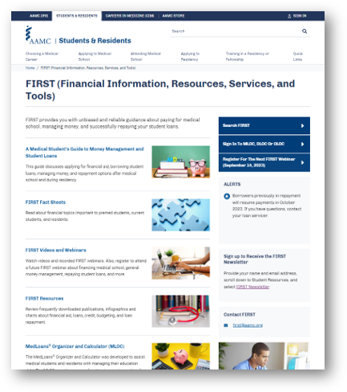
AAMC FIRST Program
aamc.org/first
Notes:
FIRST stands for Financial Information, Resources, Services and Tools and it’s a program available through the AAMC that provides unbiased and reliable information about paying for medical school, managing money, borrowing wisely (when needed), and successfully and responsibly repaying student loans. The resources through the FIRST program are available to anyone by visiting aamc.org.
Some of the helpful materials include:
Fact Sheets which short articles about topics like financing medical school, borrowing loans, money management and loan repayment.
There are also videos and live monthly webinars that people can register to attend
And there are charts, infographics, and publications available through the resources section of the program.
In addition to these resources, there are also loan repayment tools and financial education resources that will be discussed later in this presentation.

Slide 23
Resources
AAFP – aafp.org
AAMC FIRST Program – aamc.org
AAMC Careers in Medicine Program – aamc.org/cim
Health Resources Services Administration – hrsa.gov
Public Service Loan Forgiveness – studentaid.gov/pslf
Veterans Administration - vacareers.va.gov/careers/physician-jobs
Financial Aid Staff
Notes:
Develop a relationship with an informed financial aid administrator or advisor who can advise on loan repayment options, grants, scholarships, and debt management

